Slide 1

United Kingdom Maritime Accident Investigation Branch (MAIB) Report 22/2017—Grounding of Bulk Carrier Munos off the East Coast of England on 3 December 2015
Michael Kushla
13 March 2018
1

Slide 2
Agenda
Summary of casualty.
Vessel Parameters.
Onboard navigational systems.
Timeline.
Original Passage Plan vs. amended Passage Plan.
MAIB conclusions.
MAIB Action Item.
The Prudent Mariner (with takeaways).
Heinrich’s Domino Theory (with takeaways).
Effect on NIPWG and HOs.

Slide 3
Summary of Casualty
Muros enroute from Teesport, United Kingdom to Rochefort, France with a cargo of bulk fertilizer.
Original Passage Plan—Transit via North Hinder Junction.
Amended Passage Plan—Transit via Sunk Traffic Separation Scheme.
Vessel aground on Haisborough Sand on early morning of 3 December 2016 on a falling tide.
Vessel refloated on 9 December 2016.
Vessel towed to Rotterdam, Netherlands to repair rudder damage.

Slide 4
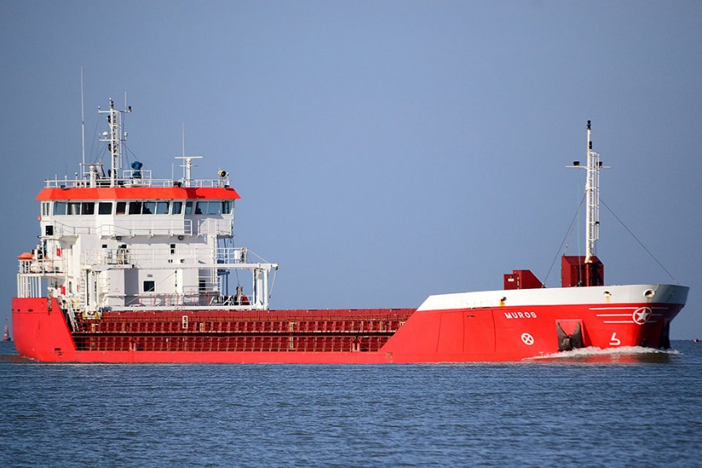
Vessel Parameters
Vessel name: Muros
Flag: Spain
Size: 2,998 gross tons
Length overall: 89.9 meters
Draft: 6.03 meters (forward) 6.13 meters (aft)
Cargo: Bulk fertilizer
Crew: Nine
Last port: Teesport, United Kingdom
Next port: Rochefort, France

Slide 5
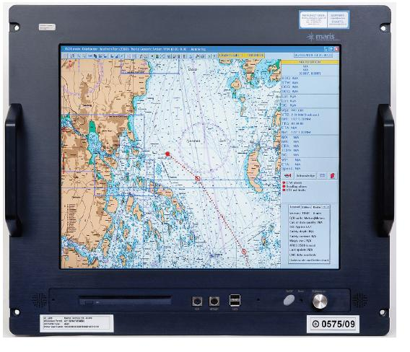
Onboard Navigation Systems
1. ECDIS (Marine Navigation System AB Type ECDIS 900 (MARIS ECDIS900) Mk 10)—Functioning correctly.
2. Vessel navigated on Electronic Navigation Charts supplied by PRIMER, operated by the Norwegian Hydrographic Service.
3. The vessel did not carry paper charts.
4. Radar—Functioning correctly.
5. Bridge Navigational Watch Alarm System (BNWAS)—Functioning correctly. Set to alert at 3-minute intervals.
6. Echo sounder—Switched off after departing Teesport.

Slide 6
Timeline
Date Time Event
2-3 December 2016 2000-0010 Master on bridge.
Autopilot steering.
Course: 146⁰.
Speed: 11.2 knots.
Transit via North Hinder Junction.
2 December 2016 2350 Second Officer (2/O) on bridge to relieve Master.
2-3 December 2016 2350-0010 Watch handover from Master to 2/O.
Master instructed 2/O to amend Passage Plan to transit via
Sunk Traffic Separation Scheme vice original transit via
North Hinder Junction.
3 December 2016 0025 2/O adjusted autopilot steering to 140⁰ based on amended
Passage Plan.
0208 2/O adjusted autopilot steering to 146⁰.

Slide 7
Timeline (continued)
Date Time Event
3 December 2016 0220 2/O noticed speed on ECDIS display reduced from 10.2
knots to 9.1 knots.
0228 2/O noticed change in ship’s motion and speed reduced to
0.8 knots.
Shifted to manual steering.
Notified Master.
0229 Master and Chief Engineer on bridge.
0330 Vessel firmly aground on a heading of 190⁰.
0357 Humber Coastguard notified about vessel grounding.
0930 Unsuccessful attempt to refloat vessel at High Water.
4 December 2016 Morning Salvors arrived.

Slide 8
Timeline (continued)
Date Time Event
9 December 2016 Unknown Vessel refloated and towed clear of Haisborough Sand.
Vessel towed to Rotterdam, Netherlands for repairs to
rudder.

Slide 9
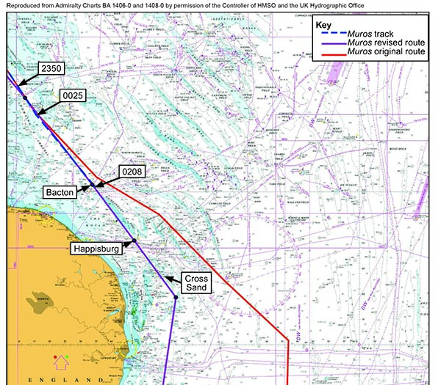
Comparison of original Passage Plan with amended Passage Plan

Slide 10
Conclusions from United Kingdom MAIB Report 22/2017
The amended Passage Pass was inherently unsafe.
ECDIS system and procedural safeguards intended to prevent groundings overlooked, disabled, or ignored.
Visual check of amended Passage Plan by 2/O did not identify the unsafe track over Haisborough Sand.
The track of the amended Passage Plan not planned or checked on an appropriate scale chart.
The use of the “standard” chart view limited the display of information and allowed the reliance upon visual checks when passage planning to be prone to error.

Slide 11
Conclusions from United Kingdom MAIB Report 22/2017 (continued)
Audible alarms were disabled and the guard zone removed.
The ECDIS not used as expected by the regulators or the equipment manufacturers.
Amending the Passage Plan interfered with the watchkeeping duties of the 2/O.
Master did not check or approve the amended Passage Plan.
Time of day and fatigue may have reduced the effectiveness of the 2/O.

Slide 12
MAIB Action Item
A joint safety study to be conducted by the United Kingdom Marine Accident Investigation Branch and the Danish Maritime Accident Investigation Board with the following emphasis:
Why mariners use ECDIS in ways not in accordance with instructions and guidance provided by system manufacturers and regulators.
Provide comprehensive data to improve functionality of future ECDIS systems.
Use this data to encourage greater use of operator experience and human-centered design principles.
12

Slide 13
The Prudent Mariner
“The Prudent Mariner will not rely solely on and single aid to navigation, particularly a floating aid.
An aid to navigation also refers to devices or structures external to a vessel which are designed to assist in the determination of position, including celestial, terrestrial, and electronic means, including Global Position Systems (GPS) and Differential GPS (DGPS).”
U.S. Special Paragraph No. 1 of 2018
13

Slide 14
Takeaways from The Prudent Mariner Concept
ECDIS is one Aid to Navigation (ATON).
Echo sounder is a second ATON.
Echo sounder not being operated (based on MAIB Report).
Critical navigation safety information (depth under the keel) from a second ATON was not available to watchstanders.
Compare the results of a “soft grounding” at a speed approaching 0 knots with the “hard grounding” which began at a speed of 11.2 knots.
14

Slide 15
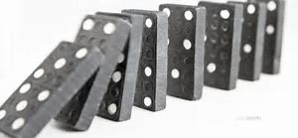
Heinrich’ s Domino Theory
“Accidents resulting from a chain of sequential events, metaphorically like a line of dominoes falling over. When one of the dominoes falls, it triggers the next one, and the next … —but removing a key factor (such as an unsafe condition or an unsafe act) prevents the start of the chain reaction.”
Disaster Management Institute, Bhopal

Slide 16
Takeaways from Heinrich’s Domino Theory
Big Domino #1—Amended Passage Plan:
Water depth = 5.0 to 6.2 meters.
Maximum draft = 6.16 meters.
Guaranteed grounding situation.
Big Domino #2—Process of amending the Passage Plan:
Occurred during and slightly after the watch handover.
Conflict between watchstanding duties and process of amending the Passage Plan.
Potential 2/O fatigue affecting procedures for amending the Passage Plan.
If proper ECDIS procedures were followed, resulting in the elimination of one of the “dominoes” described in the MAIB Report conclusions, the grounding could have been avoided.

Slide 17
How This Affects NIPWG and HOs
The nautical information provided by HOs for display on an ECDIS (or in another other distribution method) must be accurate, timely, and relevant.
Providing accurate, timely, and relevant nautical information will lessen the chance of HO failures being one of the “falling dominoes.”

Slide 18

UNCLASSIFIED
18
UNCLASSIFIED

